Slide 1

HI!

Slide 2
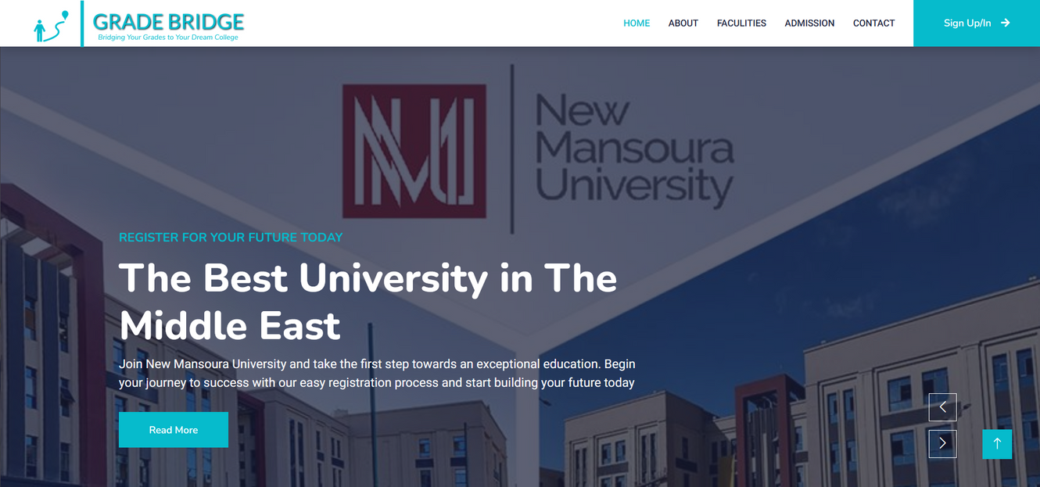

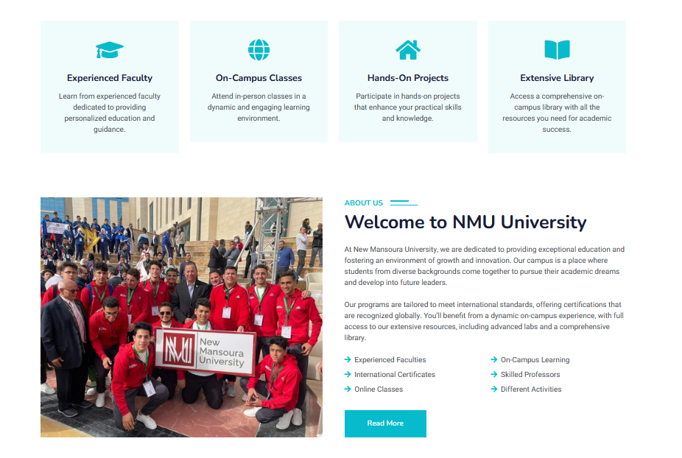
Grade Bridge
Bridging Your Grades To Your Dream College

Slide 3





TEAM
Muhammed Usama
Mustafa Mahmoud
Yara
Mohammed
Abdullah Aboshosha
Youssef
Awad

Slide 4
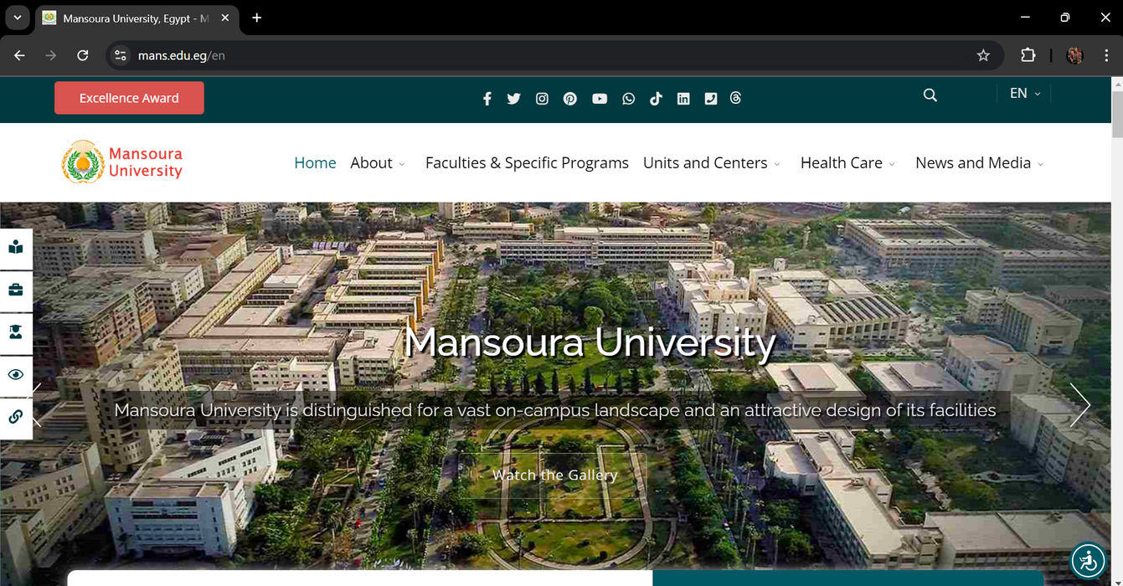
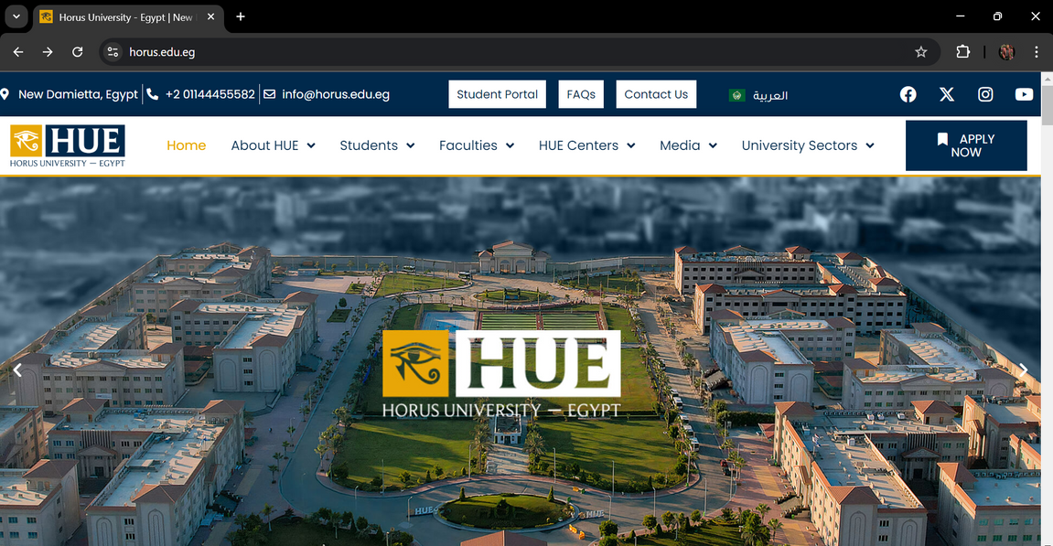
Problem?
The current student registration process is manual and paper-based, leading to inefficiencies and errors. Students face difficulties in selecting and enrolling in courses due to limited access to real-time information. Administrative staff struggle with managing and processing registrations, which results in delays and increased workload.

Slide 5

PROJECT OBJECTIVES
Providing Personalized Recommendations
Automating Faculty Selection
The platform automatically matches students’ grades with eligible faculties, eliminating the need for manual research and ensuring accurate results based on real-time data.
Grade Bridge offers tailored faculty suggestions based on a student’s grades and preferences, helping them find the best academic fit for their strengths and interests.
Reducing Overcrowding and System Failures
Enhancing Accessibility for All Students
By moving the application process online, the platform reduces physical crowding at universities and ensures stable performance during high-demand periods.
The platform is designed for easy use across different regions and educational backgrounds, including support for multiple languages, ensuring access for all students.

Slide 6
Solution
Grade Bridge is a web-based platform designed to simplify the faculty selection process for students by automating and centralizing university admissions. The platform allows students to input their grades and receive a tailored list of eligible faculties based on up-to-date admission criteria. This reduces overcrowding and system overloads, and ensures that students receive accurate, personalized recommendations. Grade Bridge provides an accessible, user-friendly solution that empowers students to make informed decisions, enhancing the overall experience of transitioning to higher education.

Slide 7

KEY FEATURES
Automated Faculty Matching
Real-Time Admission Criteria Updates
Students can input their grades, and the system automatically generates a list of faculties where they meet the admission criteria, reducing manual effort and errors.
The platform provides up-to-date admission requirements from various universities, ensuring that students always have accurate information for their applications.
Online Registration and Application Submission
Multi-Language Support
The platform allows students to complete their entire registration and application process online, eliminating the need for in-person visits and paperwork.
To accommodate students from different linguistic backgrounds, the platform offers multi-language options, enhancing accessibility for a wider audience.

Slide 8




TECKNOLOGIES

Slide 9
IMPLEMENTATION PLAN?

Slide 10
Research and Planning
Design and Prototyping
Back-End Development
Objective: Set up the server, databases, and develop the logic for student registration, grade input, and faculty matching algorithms.
Deliverables: Functional back-end system, database architecture, API for connecting the front-end.
Objective: Create wireframes, design the user interface (UI), and prototype key pages (registration, faculty matching, etc.).
Deliverables: Low-fidelity wireframes, UI designs, clickable prototype for testing user flow.
Objective: Understand user needs, gather university admission criteria, and research technical requirements.

Slide 11
Front-End Development
Launch and Deployment
Testing and QA
Objective: Develop the user-facing components, integrate with the back-end, and ensure responsiveness across devices.
Deliverables: Fully developed front-end with a responsive UI, connected to the back-end for live data retrieval.
Objective: Conduct thorough testing for functionality, usability, and security; perform load tests to ensure system stability during peak usage.
Deliverables: Bug-free platform, test reports, optimized performance metrics.
Objective: Deploy the platform to a live environment and ensure smooth operation; offer user training if necessary.
Deliverables: Live, fully functional platform, documentation for users and administrators.

Slide 12
Challenges and Risk Management?

Slide 13
System Overload During Peak Times
Security and Data Privacy Concerns
User Adoption and Resistance to Change
Challenge: Handling sensitive student data (grades, personal information) poses security risks.
Risk Management: Implement strong encryption, secure authentication, and data privacy protocols (e.g., GDPR compliance). Regularly conduct security audits and use secure hosting services.
Challenge: Students and universities may be reluctant to adopt the new system due to familiarity with traditional methods.
Risk Management: Provide training sessions, tutorials, and a user-friendly interface to ease the transition. Offer support services and educational campaigns to demonstrate the benefits of the platform.
Challenge: High volumes of traffic during admission periods could lead to system crashes or slow performance.
Risk Management: Use scalable cloud infrastructure to handle peak loads and conduct load testing to ensure the platform can manage heavy traffic smoothly.

Slide 14
Lets Talk Business!

Slide 15

Customer Segments
Primary Users:
High School Graduates
Students Seeking University Admission
Secondary Users:
Educational Institutions (Private Universities, ETC...)

Slide 16
Value proposition
Simplifies the process of faculty selection by providing tailored faculty recommendations based on student grades.
Reduces the manual effort and complexity involved in applying to universities.
Offers students a user-friendly, accessible, and efficient platform for making critical educational decisions.
Provides universities with potential students who are a good match for their programs, facilitating easier admissions

Slide 17
Channels
Website: Primary platform for accessing the Grade Bridge service.
Social Media: Engaging students through platforms such as Instagram, Facebook, and Twitter to raise awareness.
University Fairs: Physical or virtual participation in student counseling events and university fairs to reach potential users

Slide 18
Customer Relationships
Self-service: The platform allows students to independently input their grades and receive faculty.
Support Services: Offering customer support through email, and help center to resolve user queries and issues.
Community Engagement: Building an online community through forums and social media to encourage peer-to- peer support among students

Slide 19
Revenue Streams
Freemium model: Core features of the platform are offered for free to all students, while premium features such as personalized counseling, detailed faculty comparisons.
Advertisements: Monetization through relevant ads from educational institutions, private universities, and education-related businesses.
Partnerships: Collaboration with universities and educational organizations, offering them premium access to insights about potential applicants and facilitating student recruitment.
Sponsored Content: Universities may sponsor content or run advertisements targeting students interested in their programs.

Slide 20
Key Resources
Skilled development team to manage the technical aspects of the platform.
Access to up-to-date data on faculties, admission criteria, and grading systems.
Strong partnerships with universities and educational organizations to provide verified data and increase user trust.
Marketing and sales teams to handle promotions and collaborations with institutions.

Slide 21
Key Activities
Development and maintenance of the Grade Bridge platform, ensuring its functionality and scalability.
Continuous updating of faculty data and eligibility criteria to ensure accuracy.
User acquisition strategies through marketing campaigns targeted at students and educational institutions.
Building partnerships with universities and private educational organizations. for potential collaborations.

Slide 22
Key Partnerships
1.Educational Institutions:
Universities and Colleges: Provide accurate faculty and admission data to ensure up-to-date recommendations.
High Schools: Promote the platform to students during the application process.
2.Government Bodies:
Ministry of Education: Ensure compliance with policies and access
official data. Accreditation Agencies: Verify the authenticity of faculty information.

Slide 23
Key Partnerships
3.Technology Partners:
Web Hosting and Data Security Firms: Ensure platform reliability, scalability, and data protection.
Payment Gateways: Facilitate secure transactions for premium features.
Marketing and Outreach Partners:
Education Consultants and Influencers: Promote the platform through expert services and social
media outreach. Advertising Networks: Target high school students with focused marketing. Private Sector and NGOs:
Scholarship Foundations: Integrate scholarship opportunities for eligible students.
Corporate Sponsors: Offer internships and career opportunities for students

Slide 24
Cost Structure
Costs associated with web hosting, software development, and platform maintenance.
Marketing expenses for user acquisition campaigns and university partnerships.
Data acquisition costs for maintaining accurate and updated faculty and admission citeria information.
Salaries for the development, marketing, and support teams.

Slide 25


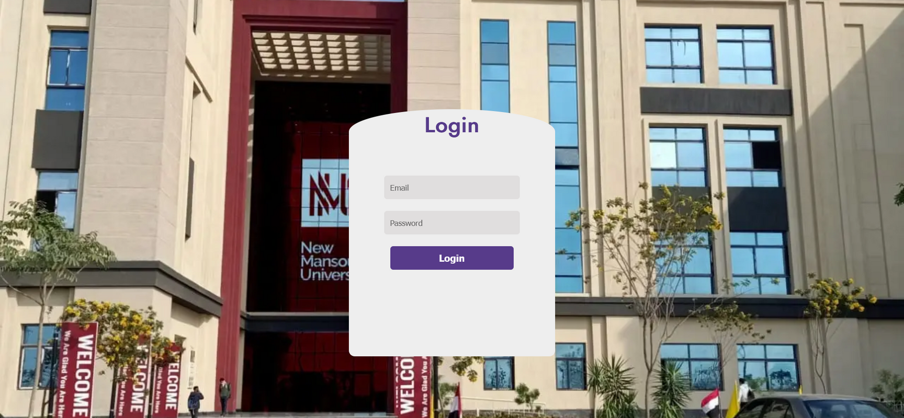
Conclusion
The college registration platform addresses key challenges in the university admission process by simplifying faculty selection, automating eligibility matching, and providing real-time information. It reduces the burden on students, offering an accessible, and efficient system. By streamlining the registration process, the platform enhances decision-making, eliminates manual errors, and reduces physical overcrowding during peak periods. Ultimately, it empowers students to make informed academic choices, paving the way for their success in higher education..

Slide 26
Live Demo
addmission.great-site.net

Slide 27
QUESTIONS?

Slide 28
THANKS

